Slide 1
Board of Directors Meeting
January 30, 2017
Hayward City Council Chambers Hayward, CA

Slide 2
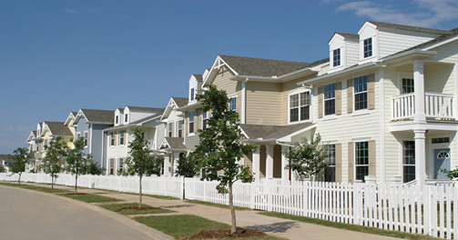
Welcome!
Directors | Alternates | Municipality
Supervisor Scott Haggerty | Supervisor Nate Miley | Alameda County
Vice Mayor Nick Pilch | Councilmember Peter Maass | Albany
Mayor Jesse Arreguin | Councilmember Sophie Hahn | Berkeley
Mayor David Haubert | Vice Mayor Don Biddle | Dublin
Mayor Dianne Martinez | Councilmember Scott Donahue | Emeryville
Councilmember Vinnie Bacon | Vacant, to be named | Fremont
Councilmember Al Mendall | Councilmember Elisa Marquez | Hayward
Vice Mayor Steven Spedowfski | Vacant, to be named | Livermore
Councilmember Dan Kalb | Councilmember Abel Guillen | Oakland
Councilmember Tim Rood | Councilmember Jen Cavanaugh | Piedmont
Vice Mayor Lee Thomas | Councilmember Ed Hernandez | San Leandro
Councilmember Lorrin Ellis | Councilmember Gary Singh | Union City

Slide 3
Item 5: Implementation Team
County Community Development Team
Chris Bazar, Albert Lopez, Sandi Rivera, Bruce Jensen
CCA Consulting Team
Tom Kelly, Seth Baruch, Shawn Marshall (Sequoia Foundation)
Legal Team
Andrea Weddle (Alameda County Counsel)
Greg Stepanicich and Inder Khalsa (Richards Watson & Gershon)
Additional Consultant Support (Agenda Item 11)
Marketing and Community Outreach
Technical and Energy Services
Data Management, Call Center

Slide 4
Item 10: Implementation Update
Major Milestones Thus Far…
In June 2014, the County BOS authorized $1.325 million to assess CCE in Alameda County. Another $2.4 million was approved in October 2016 to support program implementation and a ‘local devt. business plan’.
A 39-member Steering Committee met for 18 months to assist with developing program goals, completion of a technical study, and negotiating the JPA Agreement. The County and 11 of its cities passed the required CCE ordinance and JPA Agreement to move forward.
The program has a name, logo, website and basic info brochure. Much more to come w/r/t stakeholder and public outreach. www.ebce.org
Additional contract support in the areas of technical and energy services, marketing and outreach, and data management is underway.
Bid solicitation for a ‘local development business plan’ is underway.

Slide 5
Item 10: Implementation Update
EBCE Program Goals:
Provide electricity rates that are lower or competitive with those offered by PG&E for similar products;
Offer differentiated energy options (e.g. 33% or 50% qualified renewable) for default service, and a 100% renewable content option in which customers may “opt-up” and voluntarily participate;
Develop an electric supply portfolio with a lower greenhouse gas (GHG) intensity than PG&E, and one that supports the achievement of the parties’ greenhouse gas reduction goals and the comparable goals of all participating jurisdictions;
Establish an energy portfolio that prioritizes the use and development of local renewable resources and minimizes the use of unbundled renewable energy credits;

Slide 6
Item 10: Implementation Update
EBCE Program Goals (continued):
Promote an energy portfolio that incorporates energy efficiency and demand response programs and has aggressive reduced consumption goals;
(Demonstrate quantifiable economic benefits to the region (e.g. union and prevailing wage jobs, local workforce development, new energy programs, and increased local energy investments);
Recognize the value of workers in existing jobs that support the energy infrastructure of Alameda County and Northern California. The Authority, as a leader in the shift to a clean energy, commits to ensuring it will take steps to minimize any adverse impacts to these workers to ensure a “just transition” to the new clean energy economy;

Slide 7
Item 10: Implementation Update
EBCE Program Goals (continued):
Deliver clean energy programs and projects using a stable, skilled workforce through such mechanisms as project labor agreements, or other workforce programs that are cost effective, designed to avoid work stoppages, and ensure quality;
Promote personal and community ownership of renewable resources, spurring equitable economic development and increased resilience, especially in low income communities;
Provide and manage lower cost energy supplies in a manner that provides cost savings to low-income households and promotes public health in areas impacted by energy production; and
Create an administering agency that is financially sustainable, responsive to regional priorities, well managed, and a leader in fair and equitable treatment of employees through adopting appropriate best practices employment policies, including, but not limited to, promoting efficient consideration of petitions to unionize, and providing appropriate wages and benefits.

Slide 8
Item 10: Implementation Update
Phase 1: Initial Planning and Tech Study
Phases 2-3: Program Implementation and Launch
Initial BOS funds allocated in June 2014
City Load data approvals/request to PG&E
Steering Committee (SC) formed; met monthly
County webpage and stakeholder database devt.
RFP issued and Tech Study completed
Stakeholder and City mtgs.
JPA Agreement and CCE ordinance drafted
County/City ordinances and funding approval
JPA Agency forms
Technical, marketing and data mgmt. contracts
Expanded website and community outreach
Executive Search
Implementation Plan submitted to CPUC
Local Devt Biz plan underway
Agency banking and credit
• Agency staffing et al
Marketing/outreach
Energy supply RFP & power contract(s)
Call center live; customer opt-out notices
Utility bond and service agreement
Phase 1 Launch
Complimentary energy programs
20142015
2016
Q3/4 2017- Q1 2018
Q1/2 2017
J JPA Start Up/
Implement. Plan
Funding, Study, etc
JPA Agmts CCE Ordinances
Phase 1 Program Launch
8
JPA Start-up

Slide 9
Item 10: Implementation Update
Program Launch Timing - Threshold Considerations
Ability of service contractors to start work on March 1
Availability of Board to meet twice/month for next 5-6 months
Ability to complete/submit EBCE implementation plan by April 1
Ability to issue power RFP by mid-April; set rates in June
Other considerations:
Bid challenges, new member requests, time for robust and multi-lingual public outreach, program economics, market conditions

Slide 10
Item 10: Implementation Update
Key Planning Elements
Overall Project Mgmt, Governance, JPA Administration
Technical & Energy Related Services
Community Outreach and Marketing
Banking and Finance
Data Management & Call Center
Regulatory and Legislative Affairs (later)

Slide 11
Item 10: Implementation Update
Interim Support Functions & Process
Project Management, Governance, JPA Operations (County CDA)
Secretary/Board Clerk
Treasurer/Fiscal Management Support
Human Resources
Press/Public Information
These services will be outlined in an MOU or Cooperative Services Agreement between EBCE and the County and/or other Member Agencies that are providing support.

Slide 12
Item 10: Implementation Update
Local Development Business Plan (LDBP)
RFP 16-CCA-2 (12/19/2016) issued by County on behalf of EBCE to create a (LDBP).
LDBP = high-level blueprint for local power projects and renewable power potential.
Bids from vendors due back tomorrow, February 1, 2017.
Interviews will be held February 16 – 21; then, Staff will bring the preferred bid to your Board for opinion and feedback.
Ideally, winning bidder begins work before the end of March, 2017.
JPA Agreement / RFP require LDBP completion within eight (8) months of this meeting, or by the end of October 2017. Tight timeline, but possible.
As LDBP process continues, results to share with the Board, especially regarding renewable energy siting surveys required as part of the LDBP.

Slide 13
Item 10: Implementation Update
JPA Administrative Items
EBCEA Filed with Secretary of State
Next Up: Agency Insurance and researching temporary office space at the County

Slide 14
Item 11: Vendor Recommendations
October 24, 2016 - Alameda County issued RFP 16-CCA-1 for Multi-Service Technical and Administrative Tasks to progress towards implementing the East Bay Community Energy (EBCE).
a) SC-1 - Technical and Energy Services
b) SC-2 - Community Outreach, Marketing, Customer Notification
c) SC-3 - Data Management/Call Center Services.
On January 13 and 20, 2017, County Selection Committees conducted interviews of nine consultant teams.
Committees completed the interviews and scoring; the results are summarized in the Staff Memo.

Slide 15
Item 11: Vendor Recommendations
FORMAL PROTEST PROCESS EXPECTED:
Due to close scoring by the CSC and strong vendor competition, formal protests or challenges to the selection process are expected for Service Category 2 and Service Category 3 selections
Protest process is a County process, and not in the purview of the EBCE Board
Recommends that discussion on Service Categories 2 and 3 be postponed to a date following protest resolution by the County.
The protest process can take weeks or months; thus the process may have a modest effect on the predicted timeline

Slide 16
Item 11: Vendor Recommendations
SERVICE CATEGORY 1: Energy and Technical Services
Numerous complex tasks related to energy and regulation, including
Expert resource to the EBCE Board;
Work with the Board to analyze / finalize power supply mix and assist in bid evaluation, negotiations and contracting;
Develop master Power Purchase Agreements for power suppliers;
Assist in negotiations and contracting;
Prepare the Implementation Plan for certification by the California Public Utilities Commission (CPUC);
Wide variety of other essential tasks necessary to launch.

Slide 17
Item 11: Vendor Recommendations
SERVICE CATEGORY 1: Energy and Technical Services
All three firms interviewed scored more than 124 out of the possible 140 points.
Two firms (MRW and Optony) scored very closely at an average of near 125 points.
One vendor team, RS2 Energy / EES scored 134.5 points by the County Selection Committee, with strong values across the board;
All vendors have relevant experience; the RS2 / EES team appears to have a clear edge.
Budget - RS2 / EES scored very well, with a budget estimate at $211,101.75 (the highest estimate was $379,000).

Slide 18
Item 11: Vendor Recommendations
SERVICE CATEGORY 1: Energy and Technical Services
Based on the CSC process and if no protest is submitted, Staff plans to recommend that the County Board of Supervisors approve the RS2 Energy / EES team as the winning bidder for RFP No. 16-CCA-1 Service Category 1.
Staff look to the EBCE Board for opinion and comment as to the process and suitability of the Selection Committee’s choice.

Slide 19
Item 12: Community Advisory Cmte
JPA Agreement:
Specifies the formation of a Community Advisory Committee (CAC) composed of 9 members of the public; consider diverse cross-section of interests, skill sets, and geographic regions
The CAC shall advise the Board of Directors on all subjects related to the operation of the CCA Program as set forth in a work plan adopted by the Board of Directors from time to time, with the exception of personnel and litigation decisions.
The CAC is advisory only, and shall not have decision-making authority or receive any delegation of authority from the Board of Directors
CAC Chair will have a non-voting seat on the EBCEA Board

Slide 20
Item 12: Community Advisory Cmte
Possible Next Steps:
Allow self-nomination process from interested stakeholders
Vote of the Board on staff recommendations from applicant pool or designate Nomination Committee of up to 5 Board members to evaluate and recommend CAC members (made this into one bullet)
Consider CAC models and responsibilities from other Community Choice programs as described in staff report
Provide direction to Staff who will return with action item in February

Slide 21
Item 13: New Member Info Request
Contra Costa County and their eligible cities are exploring their CCE options which include joining MCE, as five cities already have, or if possible, joining EBCE.
Formal request received on 1/23/17 from Contra Costa County for EBCE membership information
Requesting information by March 3rd in preparation for their Board of Supervisors decision in mid-March
Requesting 4 pieces of information:
1) Cost to join
2) Board representation
3) Steps/process to join
4) Estimated time of electric service delivery

Slide 22
Item 13: New Member Info Request
Considerations/Impacts:
Near-term impacts on implementation budget, staff capacity, and program timeline
Governance/Voting
Increased revenue and service territory
Other established partnerships with Contra Costa County

Slide 23
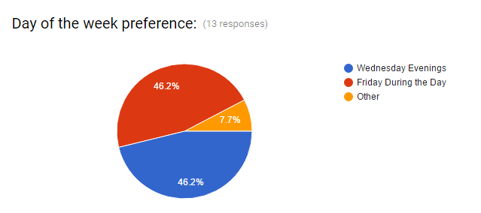
Item 14: Board Meeting Schedule
City council dates tend to fall on M-Tu-Th evenings; these days are less desirable for many Directors.
Friday evenings, likewise, are less than desirable.
Daytime meeting times allow greater schedule flexibility but less access for the public
Doodle Poll was conducted - asking Directors and alternates their preferences. Thirteen respondents from 9 cities (Albany, Berkeley, Dublin, Emeryville, Hayward, Livermore, Oakland, Piedmont, San Leandro). Results are evenly split between Wednesday evenings and Friday daytimes.
City of Hayward facilities for
meeting are generally available
at those times into the future.

Slide 24
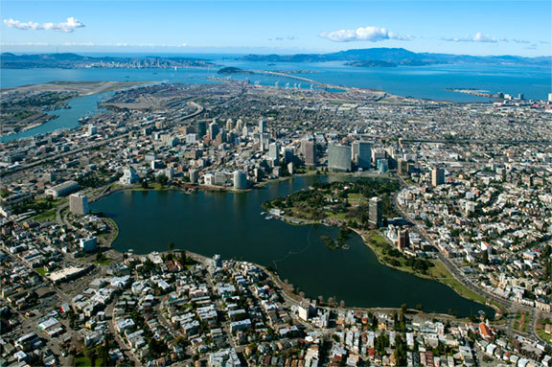
Questions?
For further information, please contact:
Bruce Jensen, Senior Planner
Alameda County Community Development Agency
(510) 670-5400
Bruce.Jensen@acgov.org

