Slide 1
Marketing Subcommittee Meeting
PRESENTED BY: MAS Team
DATE: MAY 21, 2020

Slide 2
APRIL HIGHLIGHTS
Account Services
New rate sheets for 2017, 2018, 2019 vintages for usage starting 3/1/2020
Annual NEM true up in progress
CARE documentation and outreach
New payment plan allocation for residential accounts approved
Moves have decreased in March, April compared to 2019
New Community Research on large customers
Public Engagement
Community discussions leading up to nuclear allocation decision
Contract liaison for COVID Relief funding
Marketing
COVID Relief Fund landing page
Develop CARE enrollment assets
Website updates
Hyperlocal sponsorships
General
Continued negotiations with SMUD on contract extension
Work on Budget for next fiscal year

Slide 3
PURPOSE OF SPONSORSHIPS
Increase general brand awareness and understanding of EBCE
Develop a network of community partners who can help spread the word on programs and other key information
Rather than spend money on traditional advertising channels (TV commercials, billboards), invest money into community-focused programs, events, and organizations
During COVID, contribute to the likelihood that the programs which make our community vibrant continue to exist into the future

Slide 4
APRIL HYPERLOCAL SPONSORSHIPS
Organization Name | Summary | Funding Amount | Serve
Waterside Workshops | Provides job training, individual wrap-around support, and outdoor recreation for low income and disconnected youth | $2,500 | Albany, Berkeley, Emeryville, Oakland
Piedmont Makers | Support/inspire K-12 S.T.E.A.M. education | $1,000 | Piedmont
Girls on the Run | After-school program where girls learn critical life skills | $2,500 | Various
Children's Health Guild | Group of volunteers dedicated to raising funds for George Mark Children's House (GMCH) and UCSF Benioff Children's Hospital Oakland (UBCHO) | $2,500 | Oakland, San Leandro
Irvington Loop | New program at Irvington High School, with weekly classes/workshops teaching everything from Finance, to Marketing, and Business Administration | $1,000 | Fremont
Oakland Jazz Workshop | Community-based nonprofit organization dedicated to passing on the tradition of jazz music to young people through year-round classes and workshops | $2,500 | Oakland
My Yute Soccer | Oakland-Grown non-profit organization envisions communities embracing differences through soccer | $2,500 | Oakland

Slide 5
LOOKING AHEAD MAY-JUNE
Account Services
May 1 PG&E rate change and PCIA increase
Public webinars about EBCE value proposition after the May BOD meeting
Work with SMUD on non-standard rate implementation, needed by August
April NEM true-up, EBCE work in May
Public Engagement
Continued COVID Relief support
Contract management
OES and San Leandro meetings
Preparing for next PSPS season
Marketing
Continued CARE Outreach
CARE outbound call outreach pilot, early May
Email and direct mail campaign
Print campaign
Launch website update
Prepare for additional program marketing
Email marketing software implementation
On-board Outreach Fellow and Communications Fellow
Determine what outreach looks like going forward
Notes:
High Usage SurCharge (HUC/HUS) Update
Background:
With current COVID 19 shelter in place, energy usage for residential customers is on the rise.
SDG&E requested to eliminate the High Usage Charge (HUC) in an attempt to reduce summer bill spikes. In response to this request, PG&E and SCE were included in the proposed decision to consider modification of the HUC versus elimination.
What is happening?
Proposed Decision modifies the current HUC structure
Reduce the price of the HUC to 25% (currently ~75%) of the Tier 2 price per kilowatt hour through at least through 10/31/2020
Between 11/1/2020 & 11/15/2020, PG&E will return to the price ratio utilized on 5/31/2020, unless the Executive Order N 33 20 or a similar order to stay at home related to COVID 19, is still in place as of 10/31/2020
Proposed Decision, approved on 5/7
http://docs.cpuc.ca.gov/PublishedDocs/Published/G000/M335/K833/335833693.PDF
When?
If approved, new structure would be in place as of 6/1/2020
Decision is likely expected 5/7/2020
How does this affect CCAs?
The HUC is part of the Conservation Incentive Adjustment and is only on the T&D portion of the
rate.
HUC is not part of the generation charges
Customer Awareness
PG &E will be defaulting customers with an email onto our HUC alert program
Some customers have not seen the HUC before.
The alert program will help to avoid surprise high bills
Customers will only receive alerts if:
They are in danger of incurring the HUC (Projected to exceed 400% of baseline)
If they have incurred the HUC
The HUC alert program is available now & voluntary
Customers can unenroll

Slide 6
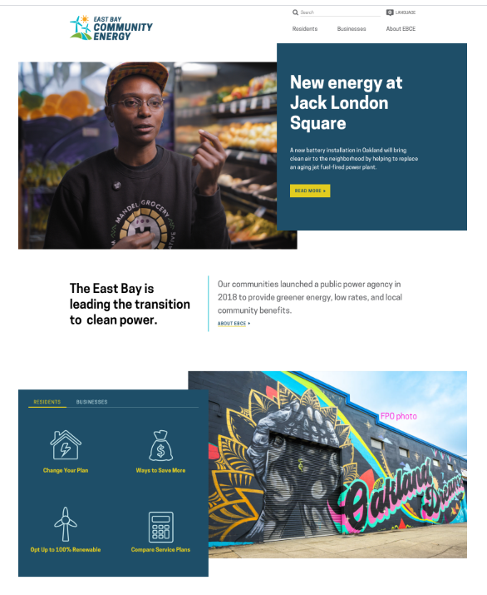
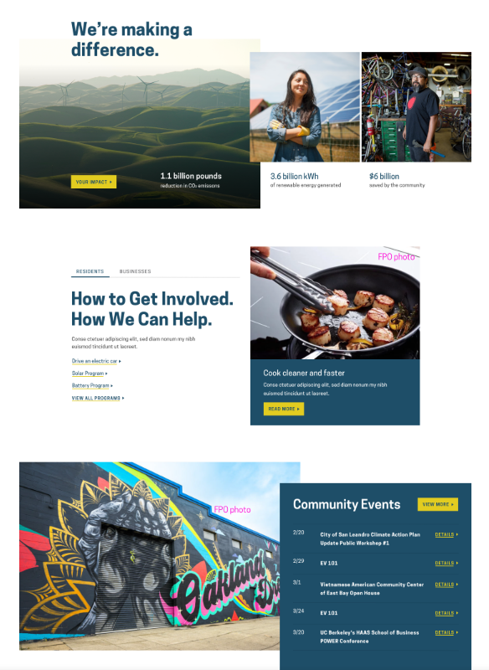
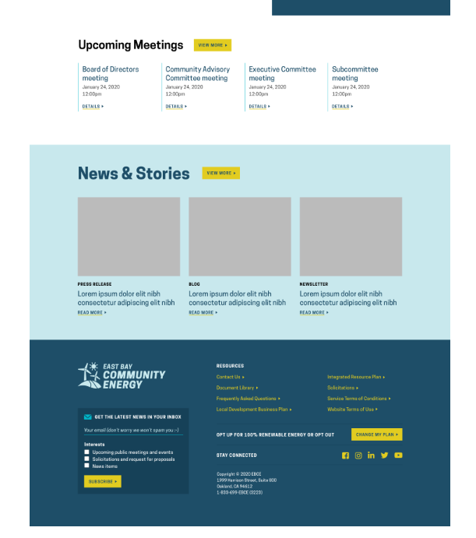
Main Page - Draft

Slide 7
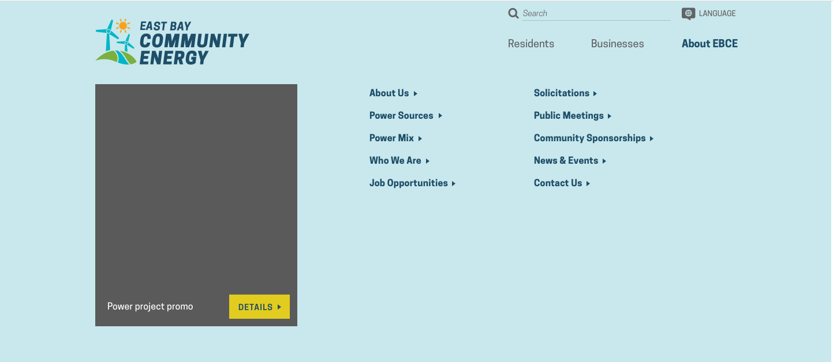
Example of Navigation Menu

